Slide 1


The Future Water Infrastructure Company
Global Investor Deck, 2026

Slide 2

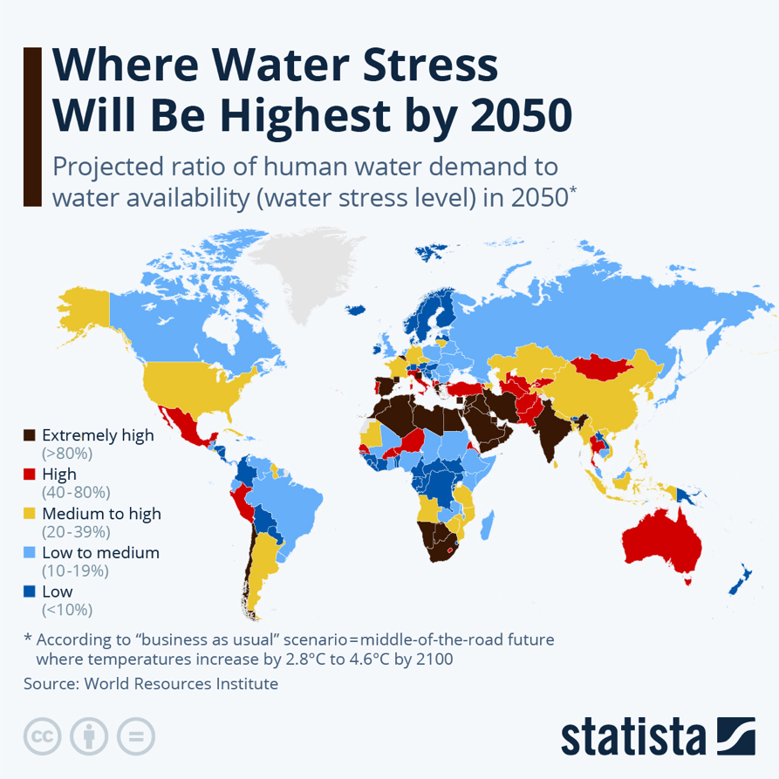
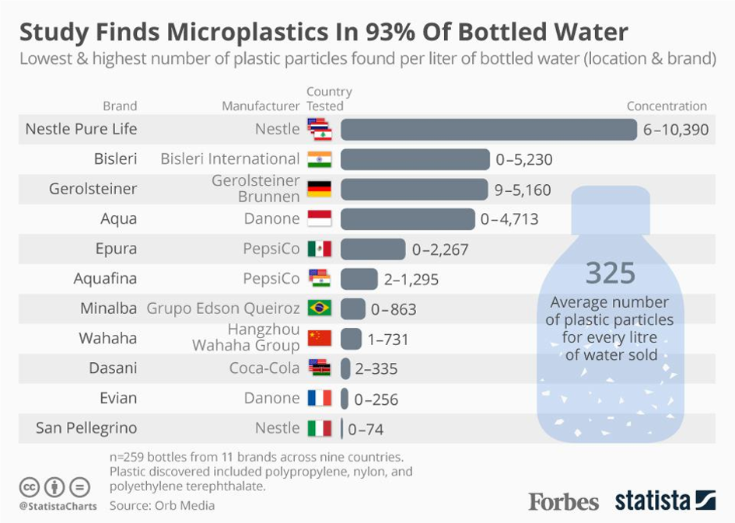
The Global Potable Water Crisis: Why Safe Drinking Water Can No Longer Be Taken for Granted
/ Problem
By 2050, over 60% of the world’s population will face water stress
Water Scarcity: 4+ billion people live in water-stressed regions — and the number is rising.
Depleting Sources: Groundwater and rivers are drying up or becoming too polluted for use.
Climate Pressure: Droughts and floods are worsening global water inequality.
Infrastructure Gaps: Rural and refugee communities often lack safe, centralized water access.
Decentralization Need: Businesses and governments need reliable, off-grid water solutions.

Slide 3
Reimagining How the World Produces Drinking Water
/ Introduction
3
Centralized Failure: Over the last century, water relied on centralized reservoirs, pipelines, and groundwater — systems now strained by climate change and population growth.
New Paradigm: Distributed water generation allows homes, businesses, and institutions to produce water locally — providing resilience, independence, and reduced environmental impact.
Key Sectors: Hospitality, commercial real estate, defence, remote communities, and rapidly growing urban markets are leading demand for off-grid water solutions.
Aeronero's Ecosystem: AWG systems + Product-as-a-Service & Subscription + Water-as-a-Service + AQUAIR bottled water — a fully integrated distributed water platform.
Global Footprint: India → Middle East → Africa → Latin America → North America. Five continents, one platform, one mission.
The Shift: Just as solar transformed electricity from centralized plants to distributed rooftop systems, atmospheric water generation is enabling the same shift in water infrastructure.
The Opportunity: Water scarcity is intensifying globally. Decentralized water generation is not a niche — it is the next infrastructure paradigm.
By 2050, 60%+ of the world’s population will face water stress. Distributed AWG infrastructure is the solution.

Slide 4
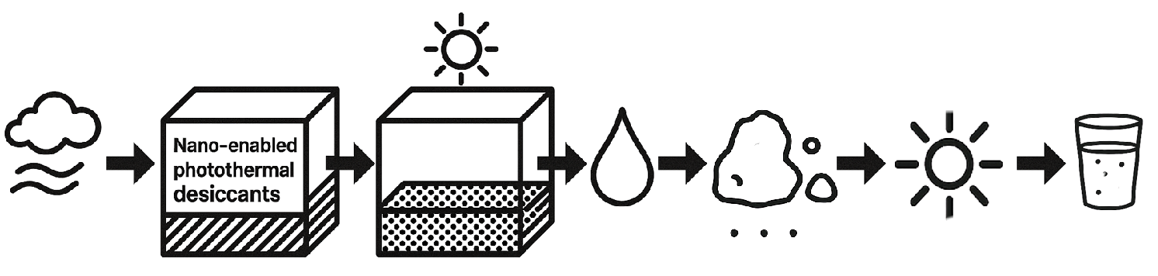

Water from air - Aeronero’s patented AWG systems generate safe, Alkaline Mineralized drinking water directly from air — with unmatched energy efficiency and scalability.
/ Deep Tech Innovation
Aeronero’s patented ConDessa technology™ transforms ambient air into pure, refreshing water, by replicating the natural water cycle, through a multi-stage process. Aeronero has been working on MOF for 5 years.
19
Patents – Process & Design
6
R&D Innovation Tracks
From efficiency to circular systems
1 of 3
AWG Climate Labs Globally
India’s only dedicated AWG lab
Condensation Approach
Desiccant Approach
Our patented system harnesses the vapor from the Earth’s atmosphere to bring Alkaline Mineralized water with the lowest energy consumption per liter produced in the market.
Desiccants work by absorbing or adsorbing moisture from the surrounding air, thereby reducing humidity levels.
Air
Condensation
Mineralization
Drinking Water
Water in
Atmosphere
Air Filter
Carbon filter
UV Sterilization
Adsorb
Desorb
Condense
Mineralize
UV Sterilize
Drinking
Water

Slide 5

/ Ethos
Vision
Water for all, always.
Mission
To pave the way for a sustainable future — as a water infrastructure company, we bridge the global water crisis.
Values
Aqua-liberty, accessibility, preservation, social equity, ethical innovation.
Your Water From Air!

Slide 6
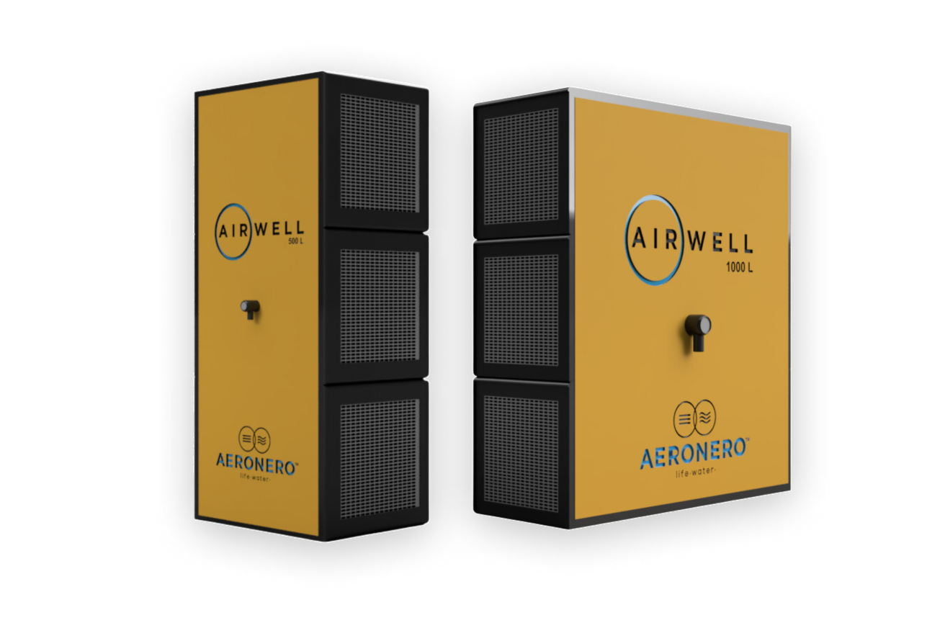
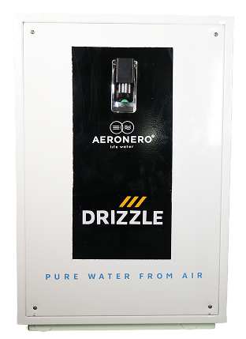
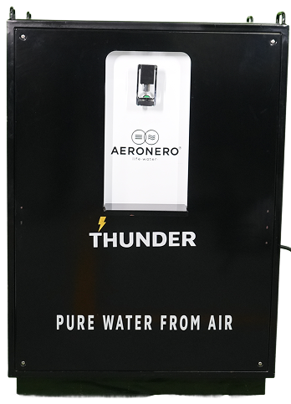
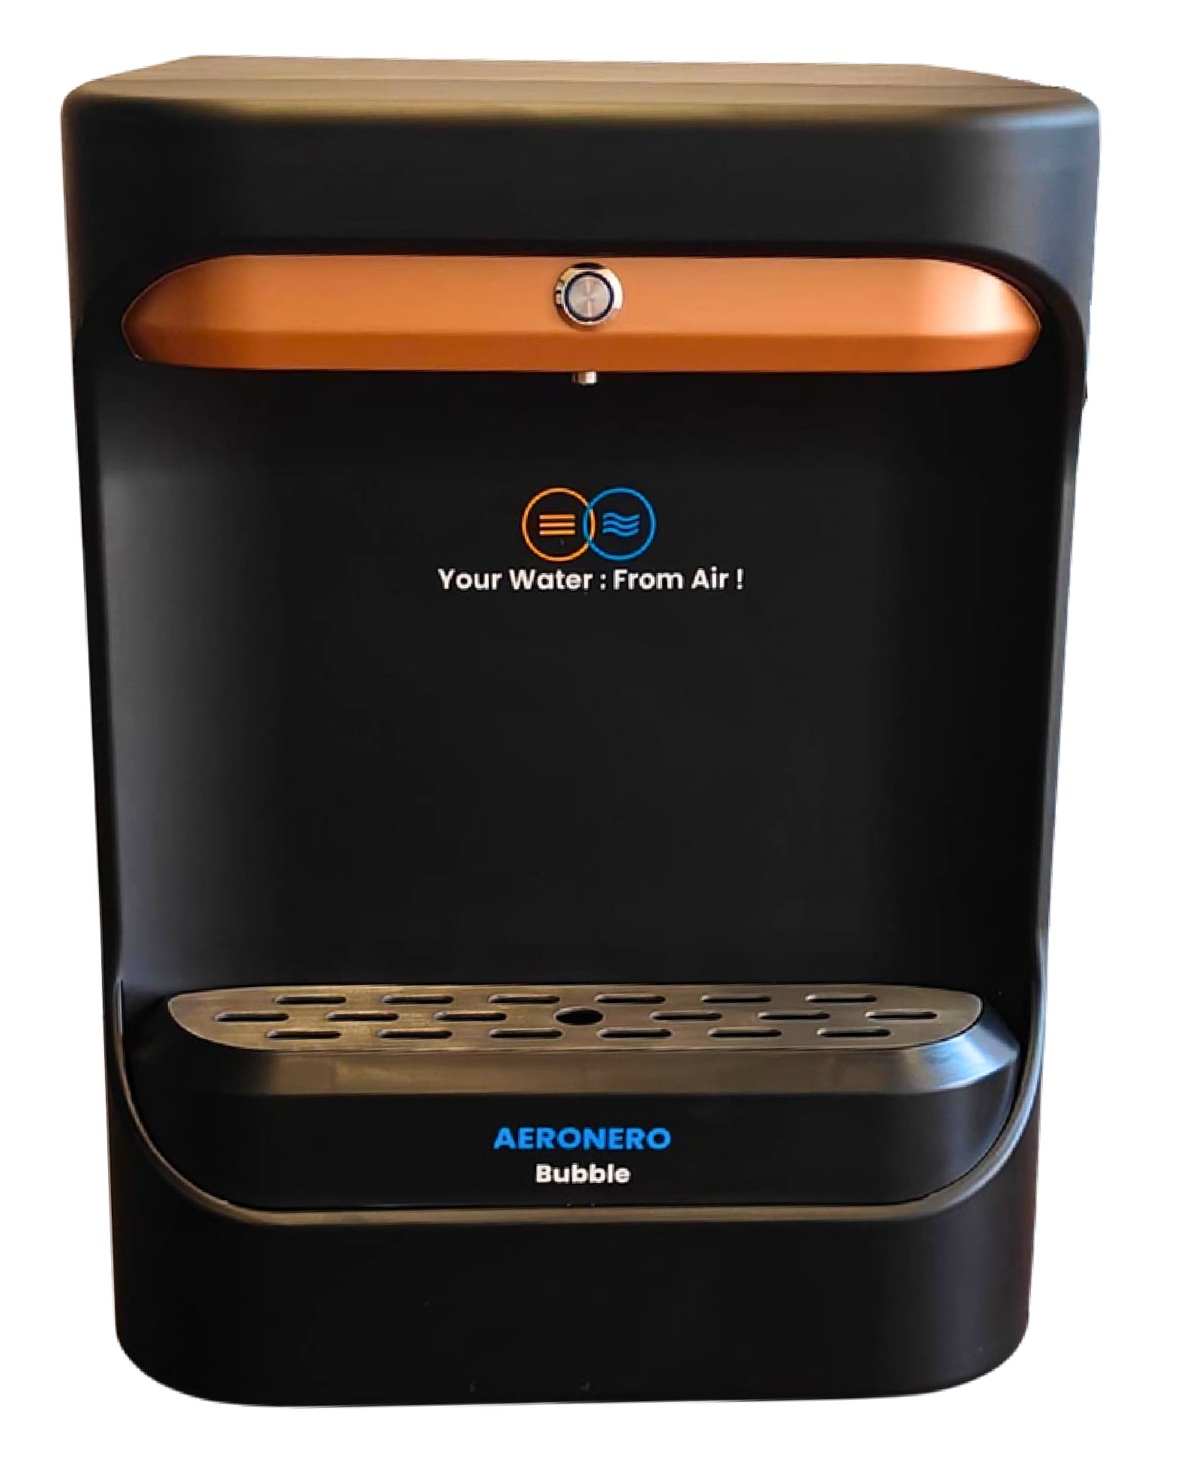




High Volume Modular Stackable Units 2.0
/ Current Product Family
Portable and Compact Units
Capacity: Up to 5gal/ 20L per day
Max Consumption: 450W
Capacity: Up to 10gal/ 40L per day
Max Consumption: 630W
Capacity: Up to 40gal/ 150L per day
Max Consumption: 2400W
Capacity: Up to 125gal/ 475L per day
Max Consumption: 7000W
Use:
Residential: small homes, apartments, small offices
Use:
Residential: large homes
Commercial: small offices, kitchens, cafes, hospitality
Use:
Residential: large homes
Commercial: Offices, hospitality, marine, communities, schools, factories, education, healthcare,
Use:
Commercial: hospitality, industrial, institution, government, communities
Highlights:
Ultra-compact design for small spaces
Simplified plug-and-play setup
Highlights:
Enhanced airflow system for higher daily yield
Highlights:
Rugged, weather-adaptable design
Single-phase operation with stable high output
Highlights:
Modular
High-capacity model for industrial and institutional use
Designed for round-the-clock operation
No downtime, no single point of failure
50/60 Hz | Grid & Off-Grid Compatible | Single-Phase & 3-Phase Operation

Slide 7
Innovation & R&D Pipeline
/ Product
Product | Capabilities | Target Market
Product Improvement & Efficiency | Next-gen energy optimization; advanced cooling, condenser systems, and MOF-class desiccants for higher water yield per kWh. Smart IoT-enabled monitoring with predictive servicing across the entire fleet. Compact, modular product development across all segments. | Cross-segment deployment — homes, hospitality, communities, and industrial sites. Drives margin expansion and improves platform-wide product lifespan.
Adverse & Diverse Climate Systems | Hybrid AWG generating clean, mineralized water year-round in low-humidity, high-temperature, and harsh conditions. Corrosion- and dust-resistant builds engineered for desert, coastal, and high-altitude deployment. Portable off-grid systems including JalVeer™ for the Indian Armed Forces. | GCC, Middle East, North Africa, and Sub-Saharan markets where conventional AWG systems fail. Defence, humanitarian, and disaster-response deployments globally — replicable for the US Army.
Sustainable Green Technologies | Solar-powered AWG systems with renewable-assisted hybrid water generation. Waste-heat-to-water recovery and HDH renewable integration (in development with Anna University). Solid-state and MOF (Metal-Organic Framework) desiccants under 5+ years of in-house research for low-humidity environments. | ESG-aligned corporate campuses, hotels, hospitals, and government facilities pursuing net-zero water and carbon goals. Real estate developers, ESG-funded infrastructure projects, and green-finance-eligible sectors. Carbon credits, water credits, and ESG procurement programs.
Industrial & Smart Infrastructure | High-capacity AWG and smart water kiosks at industrial and community scale. Centralized AeroNero Data Center — 1 of 3 AWG climate-data labs globally. | Industrial facilities, smart cities, factories, and airports — plus the data layer underpinning Aeronero’s long-term defensibility.
Aural Technology & Wellness | Sound-frequency and acoustic resonance studies on water structure. Smart vibrating bottle and cap systems integrated with AQUAIR. | Premium hospitality, wellness, and consumer hydration segments. Differentiates AQUAIR as a wellness platform — beyond bottled water.
QLNZ Circular Innovation | Wastewater treatment and circular water-economy systems. Green material and resource recovery; climate resilience projects. | Industrial wastewater, real estate, and municipal sustainability. Expands Aeronero TAM beyond AWG into broader environmental tech.

Slide 8
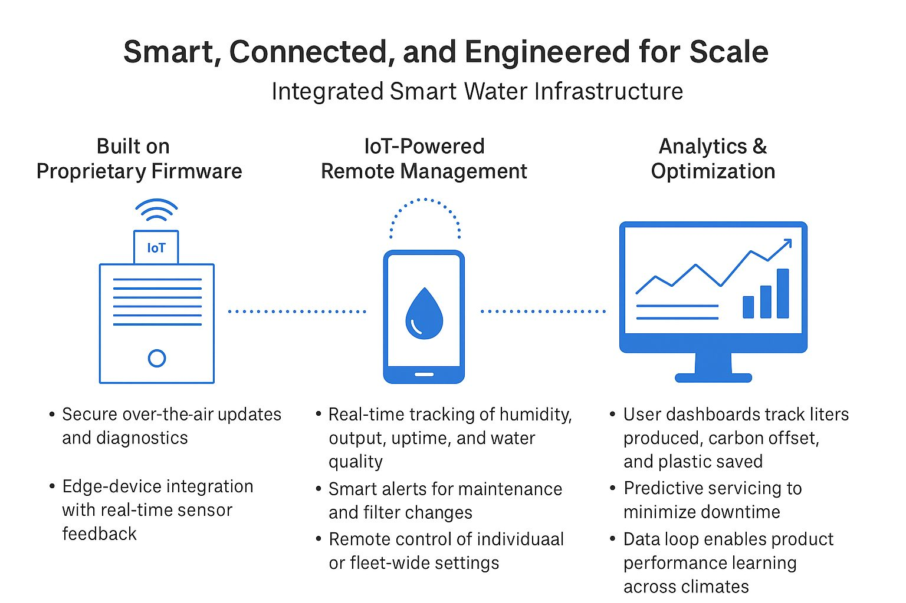
Deep Tech Stack – Integrated Smart Water Infrastructure
/ Product
Aeronero’s AWG systems go beyond basic water generation — we represent a full-stack deep tech platform combining advanced hardware, software, and IoT. Aeronero is the only company approaching this from a dual pronged approach of water extraction and energy optimization.
We don’t just make machines. We build connected infrastructure that adapts, optimizes, and scales.
🔧 Hardware & Coil Engineering
Proprietary coil and condenser design for higher water-yield-per-kWh
Engineered footprint, sound profile, and aesthetics across product lines
📲 India’s Only Climate Data Lab
Replicates global climate conditions to test AWG performance in any environment
One of only three dedicated AWG climate labs in the world
Validates hardware before international deployment — accelerating market entry
📊 IoT, AI & Predictive Intelligence
Proprietary firmware with secure OTA updates and real-time sensor feedback
Predictive servicing and anomaly detection across the entire fleet
Remote fleet management with smart alerts for maintenance and water quality

Slide 9
Aeronero Revenue Engine — A Multi-Layer Water Infrastructure Platform
/ Revenue Model
Four complementary revenue streams combine hardware, subscriptions, and recurring water service income.
1
Product Sales
2
WAAS
Direct Hardware Revenue
Water-as-a-Service
Sale of Bubble, Drizzle, Thunder, and Airwell AWG systems across residential, commercial, hospitality, defence, and institutional segments.
Channels: direct enterprise, distributor networks, builder partnerships, international exports.
WAAS (Water-as-a-Service) — powered by Airwell and Thunder units, deployed at communities, hotels, corporate campuses, institutions, and industrial facilities.
Target: 150+ plants globally within 5 years.
4
AQUAIR
4
PAAS
Premium Bottled Water from Air
Product-as-a-Service
Sustainable premium water bottled on-site from air — eliminating groundwater extraction, reducing plastic, and supporting ESG reporting.
Target: 20 global cities with AQUAIR bottling plants within 24 months.
PAAS (Product-as-a-Service) — powered by the Bubble home unit
Benefits: predictable recurring revenue, low CAC via builder partnerships, long-term contract lock-in.

Slide 10
The Aeronero Moat: A Deep Tech Company Built on Innovation, Execution, and IP
/ Advantage
🔬 Hardware Innovation
🧠 R&D Partnerships
🛡️ IP & Defensibility
Only AWG company using both condensation and desiccant — proprietary ConDessa™ hybrid
Highest water yield per kWh in the industry; reliable in deserts and high-altitude terrains
Modular product line from 20 LPD residential to 10,000+ LPD industrial scale
Collaborations with Upenn, IIT Madras, IIT Mandi, IIT Kharagpur, Anna University, ICCW, Garden City University
Co-developed AeroPanl with IIT Madras: 4.5L/day → 7.5L/day efficiency gains
Active MOU with Anna University on waste-heat recovery and wastewater treatment
Process patents: 1 granted, 1 PCT filed, 2 final-specifications filed, 4 more filing Q2 2026
Design patents: 8 awarded, 3 filing Q2 2026
9 granted patents + 10 in active filing — joint IP with IIT Madras
Patents mapped to entire product line: Bubble, Drizzle, Thunder, Airwell
🧪 Tech Pipeline
👥 Deep Tech Team
🧩 System-Level Integration Advantage
Hybrid AWG (solar-powered)
Miniature Soldier AWG for extreme mobility
Aural Technology & QLNZ Circular Platform under active development
Climate Data Lab — 1 of only 3 dedicated AWG labs globally
Deep expertise across engineering, R&D, entrepreneurship, and finance
Experience in hardware innovation, emerging markets, and capital strategy
Multiple successful exits, patent filings, and experience taking companies to pre-IPO stage
Vertical full-stack: hardware + firmware + IoT + analytics + Climate Data Lab
Remote monitoring, predictive maintenance, and smart dashboards
PAAS + WAAS + AQUAIR recurring infrastructure creates high switching costs at scale

Slide 11
Aeronero vs. Global AWG Competitors
/ Competitors
Company | Generation Capacity | Technology | IoT Integration | Patents | Water Filtration | Price | Market Stage | WaaS | Global Presence
Aeronero India | 20 LPD to 5000 LPD | Cooling Condensation, Desiccation | Yes | 19 | Sediment, Post-Carbon, Alkaline, Mineralizer, BIOVITAE, CTO Filter | $1,250 - $12,000 | Early | Yes | Yes
SOURCE USA (Global) | 6 bottles/day 3 LPD | Desiccation | No | 12 | Ozonization, Mineralization | $2,000 per panel | Growth | No | Yes
Aquaria USA (Global) | 90 LPD to 1000 LPD | Cooling Condensation | No | 2 | Unknown | $3,500 - $17,499 Lease: $210 - $460 / month | Early | Yes | No
Genesis USA (Global) | 45 LPD to 4500 LPD | Cooling Condensation | No | 3 | UF Filter, UV Treatment | $4,500 - $26,600 | Growth | No | Yes
GENAQ Spain (Global) | 50 LPD to 5000 LPD | Cooling Condensation | No | Unknown | Multi-stage Filtration | $4,250 - $34,000 | Growth | No | Yes
Uravu Labs India | Consumer: 1000-1200 LPD Commercial:4000 LPD | Desiccation | No | 2 | Unknown | Consumer: $2.50 / bottle Commercial: Unknown | Early | Yes | No
Airowater India | 25 LPD to 1000 LPD | Cooling Condensation | No | 3 in India 6 in U.S | Pre-carbon filter, Sediment filter, U.F. Filter, TCR Filter Ozonation | $680 - $30,000 | Early | No | Yes
Maithri India | 150 LPD to 2500 LPD | Cooling Condensation | No | Unkown | Sediment Filter, Activated Carbon Filter, UV Filter | $3,650 - $35,000 | Early | No | Yes
Akvo India | 30 LPD to 2000 LPD | Cooling Condensation | No | Unknown | Multi-stage Filtration, UV | $1,000 - $20,000 | Early | No | No

Slide 12
Go-To-Market Strategy: Four Channels, One Integrated Platform
/ GTM
B2B
Defense, Commercial, and Institutional Buyers
Secure strategic anchor clients (e.g., military, hospitals, hotels) as referenceable case studies
Activate master distributors and channel partners in key geographies (India, Middle East & GCC, Africa, Latin America, USA, Southeast Asia, Europe)
Water-as-a-Service (WaaS) model for hospitality to drive recurring revenue
Collaborate with CSR programs and foundations on Water-for-All initiatives
B2G
Government Programs & Procurement Portals
Win tenders via government procurement portals (e.g., GEM, defense procurement)
Position as a climate-resilient water solution in public infrastructure programs
Collaborate with NGOs and development agencies for rural and humanitarian deployments
AeroNero reaches customers across B2B, B2G, B2B2C, and WaaS channels — combining direct enterprise sales, builder partnerships, government programs, and utility-model deployments.
With a pipeline of $10M+ qualified sales across India, MENA, and early USA/LATM.
B2B2C
Consumers, Builders, Developers
Partner with residential builders to pre-install AWG units in high-end developments
Offer financing and turnkey installation packages for homes and schools
Subscription-based WaaS for households and small institutions

Slide 13












Anchor Partners Validate the Model and Open Markets
/ Partners
Academic
Anna University: Academic collaborator supporting Aeronero through research, innovation, and technical validation in water generation technologies.
Upenn: Collaborating with researchers both on campus and at Aeronero’s R&D centers in India to drive breakthrough innovation and accelerate technology development.
International Centre For Clean Water: Research collaborator advancing clean water innovation and sustainable technology.
Indian Institute of Technology Madras: Innovation partner and technology arm supporting R&D and product development.
VITS: Working on future of farming with Dean of Agriculture Department
Business
Prestige Group: Leading real estate developer committed to sustainability, integrating Aeronero’s water solutions across all upcoming projects.
Collaborating with leading institutions, corporations, and ecosystem enablers to drive scale and impact.
Trusted by global leaders across business, academia, and sustainability ecosystems.
Government e Marketplace: Official public procurement platform enabling Aeronero to supply solutions to government bodies across India.
Vecare: Service and technology partner supporting field operations, analytics, and after-sales service optimization.
White Lotus: A sustainable luxury home builder integrating Aeronero’s water solutions to enhance self-sufficiency and eco-conscious living.
Indian Army: Developing water solutions for remote and extreme environments.
Bengaluru Airport: Creating innovation hub at Bengaluru Airport City.
Greentown Labs: Advancing climate tech innovation and accelerate sustainable AWG development.

Slide 14
A multi-billion dollar market with a clear path to penetration
/ Market
TAM
$100B
Why now?
More than $1 billion of equity capital invested into water technology companies in 2024 alone — signaling massive institutional confidence in the sector.
4%
SAM
$4B
AeroNero's position
The $191M SOM reflects Aeronero’s Year-5 revenue target from the 5-year financial model — capturing 4.8% of the $4B serviceable AWG market.
Growth drivers
Declining freshwater reserves · Higher desalination cost · ESG mandates · WHO/EPA regulatory tailwinds · Climate volatility creating water emergencies globally.
4.8%
SOM
$191M
Frost & Sullivan
AeroNero recognized as a Top Growth Opportunity in Residential, HoReCa, and Commercial Water Systems in the 2025 Global Water Systems Report.

Slide 15
/ Opportunity
The Ask — $10M Growth Round
Capital Deployment Plan
Current Raise (USD)
Manufacturing Scale-Up
35%
$10M
Expand production capacity to fulfill India sales pipeline and international orders. Invest in tooling, automation, and supply chain.
25%
Water-as-a-Service & PAAS Deployment
Instrument
Roll out WAAS plants across hospitality, communities, and institutions; launch PAAS through builder partnerships. Initial target: 5–8 plants and 3 AQUAIR bottling cities within 18 months.
Equity Round or Convertible Note
20%
Innovation Roadmap & Patents
Valuation
Accelerate waste-heat recovery, AeroPanl 2.0, hybrid AWG, and new patent filings for international market requirements.
$50M
12%
International Market Entry
Revenue Pipeline
Establish distribution partnerships and local assembly hubs in Middle East, Africa, and US markets.
$10M+ qualified sales (India, MENA, US)
8%
Team & Operations
Hire commercial operations team across India, GCC, and US; scale finance, sales, and support infrastructure.

Slide 16
5-Year Revenue Projections
/ Financial Outlook
Aeronero targets $4.3M in FY1, scaling to $191M by FY5 across four revenue streams. *Projections begin from the date of funding close.
Year
Product
PAAS
WAAS
AQUAIR
TOTAL
FY 1
$2.1M
$0.5M
$0.3M
$1.4M
$4.3M
FY 2
$9.6M
$4.1M
$2.1M
$5.2M
$21.0M
FY 3
$30.2M
$14.5M
$8.1M
$10.9M
$63.7M
FY 4
$60.3M
$29.0M
$16.2M
$21.9M
$127.5M
FY 5
$90.5M
$43.6M
$24.3M
$32.8M
$191.2M
*Projections are forward-looking estimates. Recurring revenue (PAAS+WAAS+AQUAIR) represents 75%+ of revenue by FY5.

Slide 17
/ Financial Outlook
EBITDA Growth — Margin Expansion Driven by Recurring Revenue
Scale manufacturing, subscription mix, and water utility economics drive margins from 14% to 39% by Year 5.
Year
Revenue
Margin
EBITDA
FY 1
$4.3M
14%
$0.6M
FY 2
$21.0M
31%
$6.4M
FY 3
$63.7M
37%
$23.4M
FY 4
$127.5M
38%
$48.5M
FY 5
$191.2M
39%
$74.6M
Recurring Mix
Manufacturing Scale
WAAS + AQUAIR + PAAS = 75%+ of revenue by FY5
Unit economics improve significantly at volume

Slide 18
/ Financial Outlook
Unit Economics — Attractive Margins Across Every Revenue Stream (USD)
Product Sale
PAAS — Subscription
WAAS — Water Plant
AQUAIR — Bottling Plant
Mfg. Cost
Monthly Revenue
Plant CAPEX
CAPEX (2 KLD)
$663 – $3,720
$25/unit
$100K–$200K
$120K–$150K
Retail Price
Annual per unit
Annual Revenue
Annual Revenue
$1,250 - $12,000
$300
$300K–$700K
~$500K
Gross Margin
5-yr Lifetime
EBITDA Margin
EBITDA Margin
47–69%
$1,500
60–65%
~50%
Lifetime Margin
Payback Period
At 10 KLD scale
65–70%
<12–18 months
$2.5M+
Bubble, Drizzle, Thunder, Airwell — margins expand with size
200,000-home target = ~$60M ARR at scale
On-site operations + monitoring bundled
2 KLD plant generates ~$500K annualized revenue

Slide 19
/ Global Strategy
Global Scaling Strategy — Phased Expansion via Local Partnerships
IN India
200+ units deployed; Chennai-led traction across luxury hospitality, healthcare, mining, and new-build housing. Builder partnerships enable low-CAC PAAS at scale.
5-Year Deployment Targets
Primary Growth Engine
5+
AE GCC / Middle East
Distributor discussions active; luxury hotels, resorts, and healthcare facilities are early targets in regions of acute water stress.
Continents reached through distribution
Premium Water Markets
20
AF Africa
Post Cape Town-style water crises, demand for decentralized water in healthcare, refugee, and rural communities. GRN and impact-fund partnerships in place.
AQUAIR cities
Premium bottled water
Decentralized Access
150+
LA LATAM
Mexico-first: targeting water-stressed states across mining, hospitality, and mid-upper residential builders. Caribbean distributor in progress.
WAAS plants globally
Hotels & campuses
Climate-Resilient Water
200,000
US USA + Next Phase
US: California, Nevada, Arizona, Texas, Florida — ESG-driven commercial buyers. SEA: distributors in Singapore, Jakarta, KL, Australia. Europe: under exploration.
Homes via PAAS
Bubble subscriptions
USA + Southeast Asia + Europe

Slide 20
Aeronero Strategic Roadmap 2026–2031
/ Roadmap
2025
Seed
2026–27
Growth
2027–28
Series A
2030–31
Mission Accomplished
Foundation
Growth
Scale
$191M Target
▸ Raised $750K CCD + debt
▸ Close $10M growth round
▸ Raise Series A — $20M debt + $20M equity / convertible
▸ $191M revenue trajectory by FY31
▸ Launch GTM across B2B, B2G, B2B2C
▸ WAAS pilot plants — India & MENA
▸ Launch Product v3.0
▸ Strategic IPO / global expansion path
▸ India manufacturing expansion
▸ AQUAIR first 3 cities launched
▸ Deepen R&D — waste heat & hybrid AWG
▸ $1B+ valuation milestone
▸ Financial model for scalable sales
▸ Advance MOF R&D and next-gen efficiency breakthroughs
▸ Scale WAAS to 50+ plants globally
▸ 200,000 PAAS homes reached
▸ International distributor network activated
▸ AQUAIR reach 10 cities
▸ 150+ WAAS plants · 20 AQUAIR cities

Slide 21
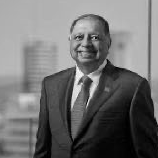
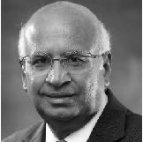
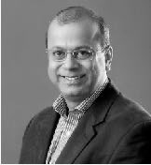



Backed by Visionary Investors
/ Investors
Prestige Group, Rezwan Razack
India’s most respected builder.
S. Ramadorai
Former Chairman on TCS and on TATA Board.
Kiran Deshpande
Former CEO of Tech Mahindra.
Callapina Capital
Early-stage fund with deep networks across India’s startup ecosystem, backing impact-focused founders.
Startup Singham
Driving grassroots innovation and investment in entrepreneurship.
Supported by a global network of believers in deep tech, sustainability, and long-term impact.
Jaamwant
Early-stage fund fueling deep tech, aerospace, defence, and ESG startups with capital, mentorship, and industry expertise.

Slide 22
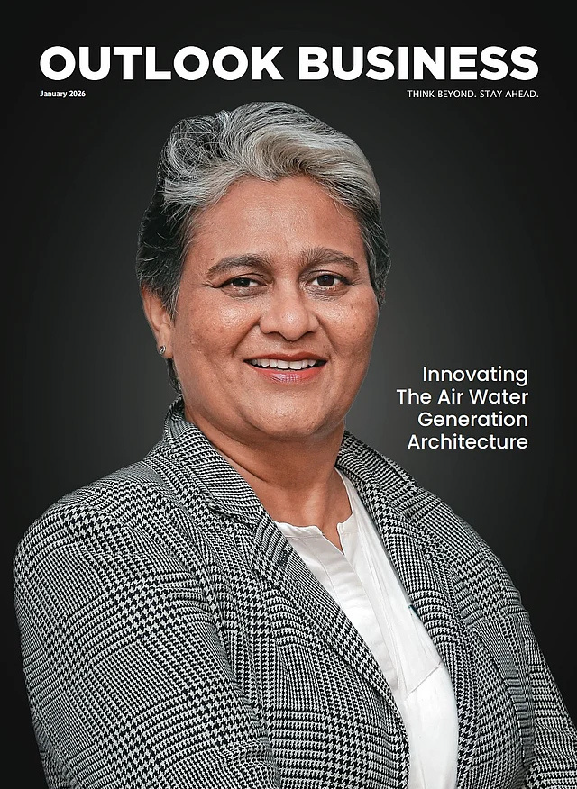
Visionary Entrepreneur.
/ Founder
Durga Das
Founder & CEO
Dr. Durga Das is Founder and CEO of AeroNero, the only AWG company globally using both condensation and desiccant technologies through its proprietary ConDessa Technology — delivering superior water yield with reduced energy consumption, operating reliably even in low-humidity and remote environments. Honored with a Doctorate in Technology and Innovation in 2025 and featured on the cover of Outlook Business Magazine's January 2026 edition as one of India's Deep Women Leaders, Dr. Das has dedicated her career to realizing her vision of Water for All, Always. With nearly 500 installations across India currently serving 1.5 million people, she has demonstrated both the commercial viability and transformative social impact of atmospheric water generation. AeroNero now operates across India, the Americas, and the Asia-Pacific region, with Aeronero Singapore established as the company's Asia-Pacific headquarters.
Beyond AeroNero, she founded WODER, a UK-based charity addressing water scarcity in refugee camps and advancing water independence for women globally. Her leadership has earned recognition including Frost & Sullivan's 2025 Global Transformational Innovation Leadership Award, Woman Entrepreneur of the Year at the HT Bharat Nirmaan Conclave, UN Empowerment SDG Challenge Finalist, selection among 23 global entrepreneurs in Reckitt's Catalyst 2025 WASH cohort, and NBC Washington's Top 31 Global Thought Leaders in Deep Tech and Sustainability, among numerous other honors. She serves as an advisor on the WICCI Water platform, Joint Secretary of the Asian African Chamber of Commerce, and co-founded the Global Air Water Generation Initiative to advance industry standards.
A graduate of the Goldman Sachs 10,000 Women Program and Vital Voices Global Women Leadership Program, Dr. Das brings over 30 years of entrepreneurial expertise including 25 years building technology in Silicon Valley spanning startup creation, strategic partnerships, and global scaling. A former professional cricketer who captained the US national team and pursued professional golf, she brings the same resilience and strategic thinking to solving one of the world's most critical challenges.
Her mission: Water for All. Always.

Slide 23




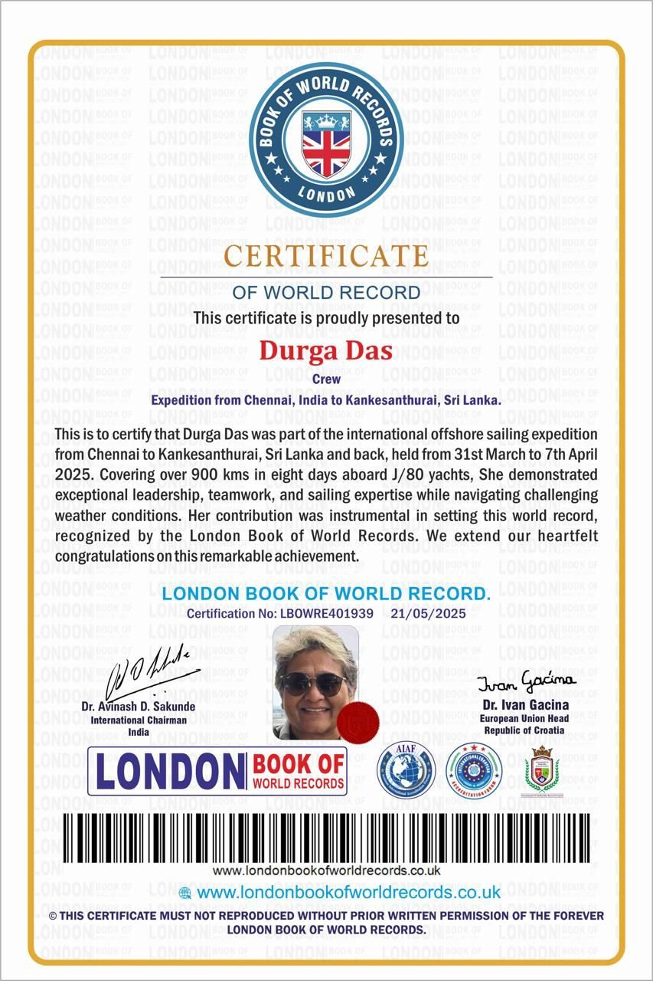
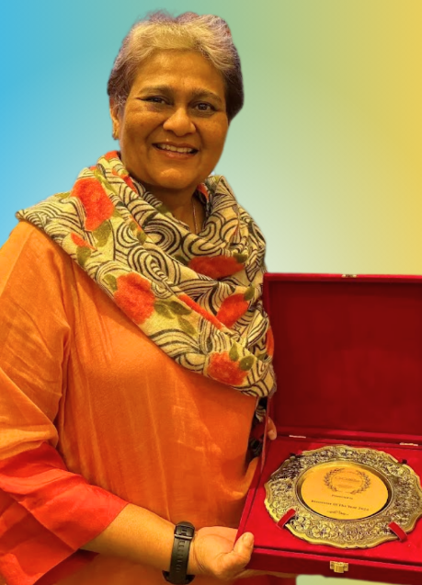
Proven recognition and awards
/ Recognition
Frost & Sullivan Global Water Systems Report (2026) – Top 10 Growth Opportunities in Residential, HoReCa and Commercial Water Systems Market
Reckitt Global Accelerator Program – Selected for Reckitt's global program advancing health and sustainability innovation
Green Capital USA – Backed by a US climate-tech accelerator supporting scalable sustainability ventures
AquaSphere Europe – European water-innovation program advancing next-generation AWG technology
Goldman Sachs 10,000 Women – Finance & Advanced Finance – Completed advanced finance programs under the Goldman Sachs 10,000 Women initiative
ISB Women Entrepreneurs Accelerator – Selected for the Indian School of Business accelerator for women founders
Wadhwani Foundation – Supported by the Wadhwani entrepreneurship and scaling program
Women Entrepreneur of the Year by HT Media Group (2025)
Top 23 Global Health & Hygiene Entrepreneurs by Reckitt Catalyst Entrepreneurs (2025)
The moment of Lift Summit & Awards Panelist (2025)
Selected for the The NextLeap Cohort (2025)
YourStory Tech30 Top 30 Startups out of 5,000 (2025)
NBC Rising Woman Series (2025) – Featured among the Top 31 Global Thought Leaders
UN SDG WE Empower Global Finalist (2025) – Selected as one of the world’s top 25 women entrepreneurs
GBW Powerhouse Women in Leadership (2025) – Recognized alongside global leaders such as the President of Iceland and Morocco’s Minister of Digital Transition
Atmanirbhar Award (2025) – Honored for advancing sustainable innovation and self-reliance in India
SDG Giving Economy Award (2024) – Malaysia, Dec 2024
Top 3 Trailblazing Entrepreneur (2024) – Recognized by FEDEX during Global Entrepreneurship Week
Most Meaningful Business (2024) – Selected from 883 nominations across 80 countries
Best Innovator & Women Achiever Awards (2024) – World Health Assembly, Geneva
Startup Singham Winner (2024) – Raised $200K in funding
Best Business Plan (2024) – Goldman Sachs 10,000 Women @ NSRCEL, IIM Bangalore
Graduate – Goldman Sachs 10,000 Women & Vital Voices Fellowship
Growth-Stage Partner – ICCW / IIT Madras
Featured Speaker (2024) – World Water Week, Stockholm, alongside Woder CEO Mansee

Slide 24
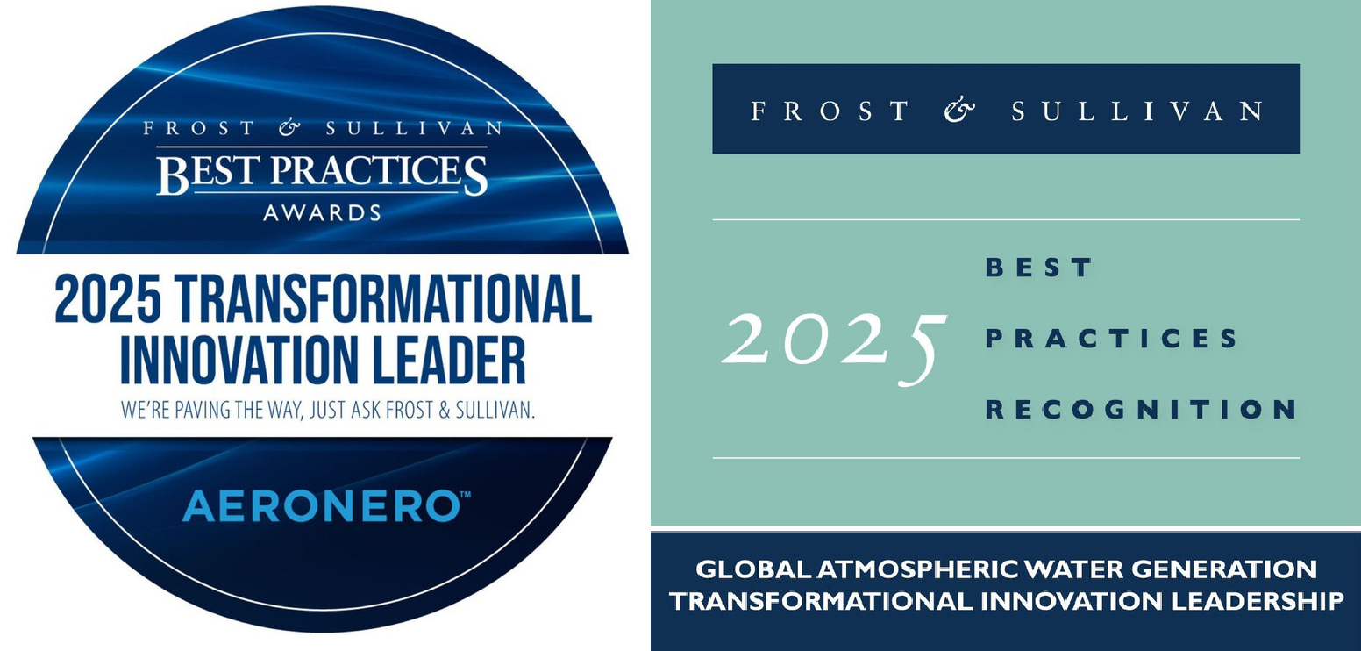
Frost & Sullivan: 2025 Global Transformational Innovation Leadership
/ Recognition
What Frost & Sullivan Found
Dual-technology AWG — Only company using both condensation & desiccant methods, operating where conventional systems fail
Best-in-class efficiency — Highest water yield per kWh with solar integration for grid-free operation
Modular IoT architecture — Real-time monitoring and predictive maintenance, home to industrial scale
30% lower cost — Water-as-a-service model removes infrastructure burden entirely
Zero plastic waste — No aquifer depletion; lower carbon footprint than bottled water
253 deployments — Across India, Americas, & Asia-Pacific — 11M+ lives impacted
"Aeronero transcends the role of a technology provider to become a catalyst for systemic change."
— Fredrick Harry Royan, Frost & Sullivan
FROST & SULLIVAN | GLOBAL AWG INDUSTRY
2025
TRANSFORMATIONAL INNOVATION LEADER
400%
Year-on-Year Revenue Growth
13
Global Patents (incl. Joint IP with IIT Madras)
22M+
Liters of Safe Drinking Water Delivered

Slide 25
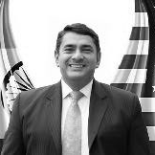
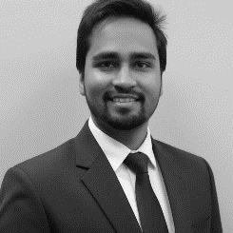
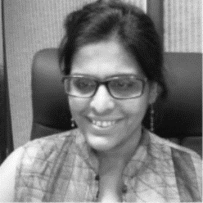
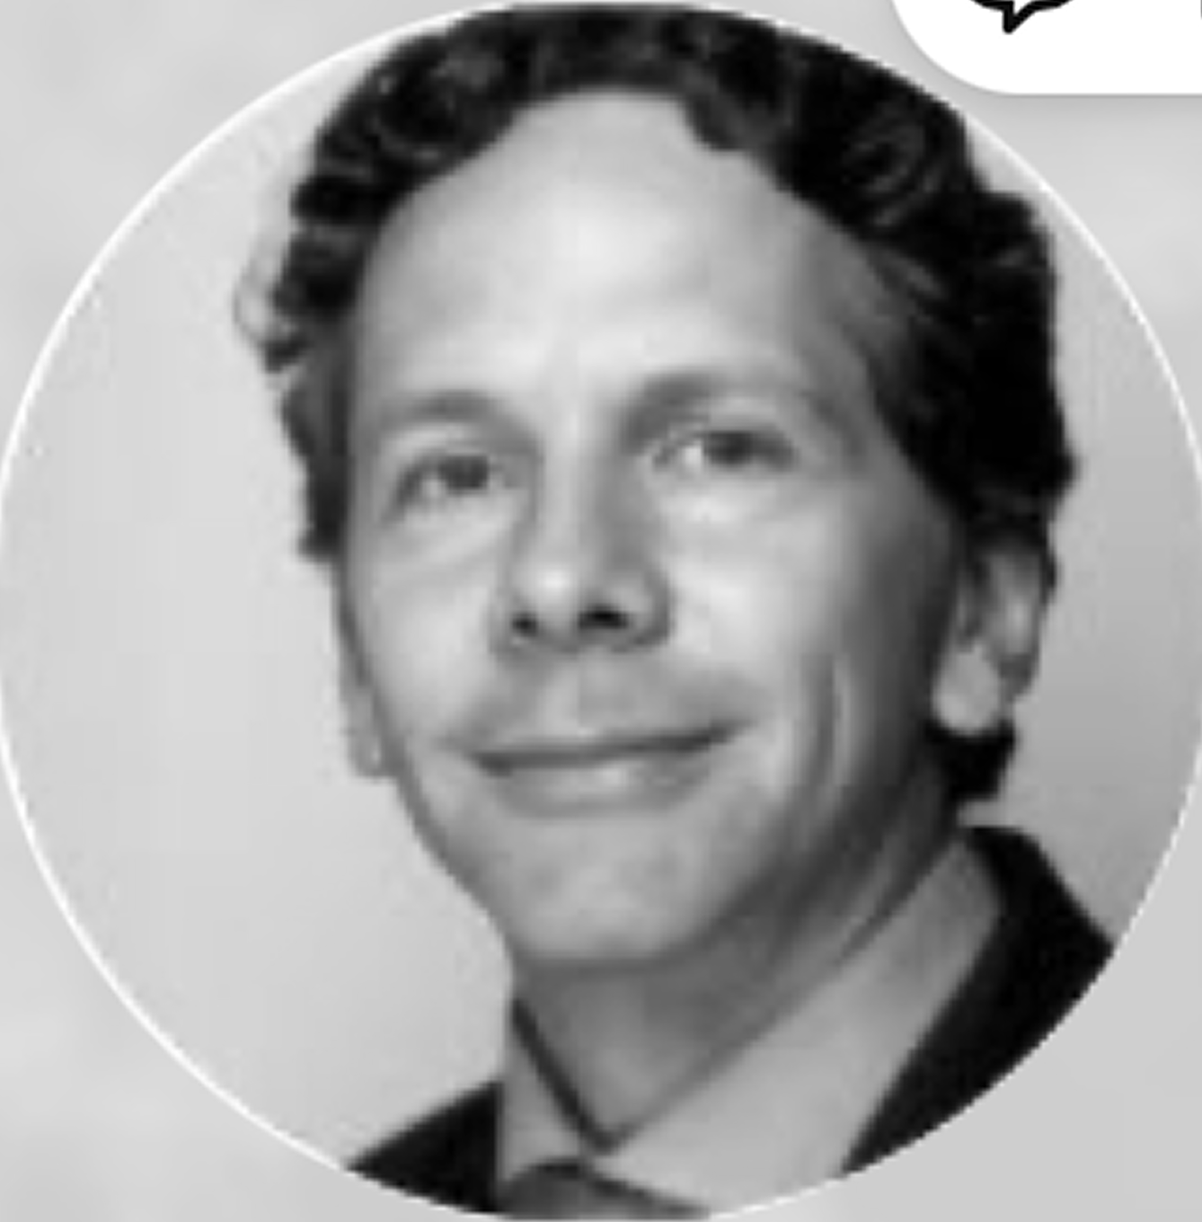
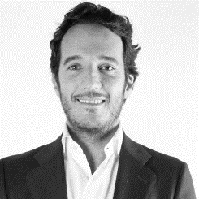
Proven Builders Backed by Experience That Matters
/ Team
Ravi Karkara: Chief Global Strategist
A global sustainability leader and co-founder of the Global Air Water Generation Initiative and Author of the AI for Food Movement Book, with 25+ years of experience at the intersection of innovation, investment, and social impact. A former UN Senior Advisor and "Global Sustainability Champion" awardee by US Congressmen, he advises boards and global leaders on embedding scalable, tech-driven sustainability strategies.
Sumit Jain: CFO
Strategic finance leader with 13+ years of experience partnering with growth-stage companies across technology, EdTech, and consumer retail. He has supported founders through fundraising readiness, investor-grade financial modeling, and scalable finance infrastructure, with prior experience at EY. Sumit is a Chartered Accountant and serves as Founder of Germin8 and Managing Partner at Jain SAK & Co., both based in Bangalore.
Sapna Harpalani: CHRO
Senior HR leader with 20+ years driving talent strategy, organizational design, and leadership development at global industrial firms including Markem-Imaje, Dentsply, and Johnson Matthey Catalysts across India, the Middle East, and Turkey. She holds an MBA specialized in Human Resources.
Enrique de la Campa: LATAM COO
Seasoned entrepreneur, led Mexico's largest renewable energy company, driving Aeronero's positive impact and stakeholder success with versatile business expertise.
Fernando de Haro: LATAM CMO
Seasoned entrepreneur with 25+ years leading ventures, including Mexico's top renewable energy company. Committed to Aeronero's success, blending business savvy with economic expertise.
Key Highlights
Serial Entrepreneurs with Global Market Experience
Active Angel Investors Backing High-Growth Startups
Multiple Successful Exits Across Sectors
Led Strategic M&A Transactions
Deep Tech & Innovation Leadership
Holds Multiple Patents in Deep Tech & Innovation

Slide 26
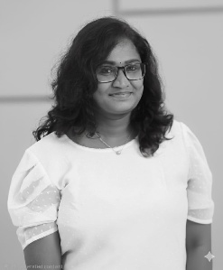
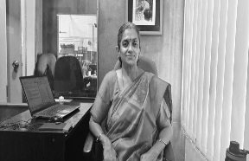
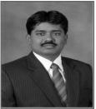
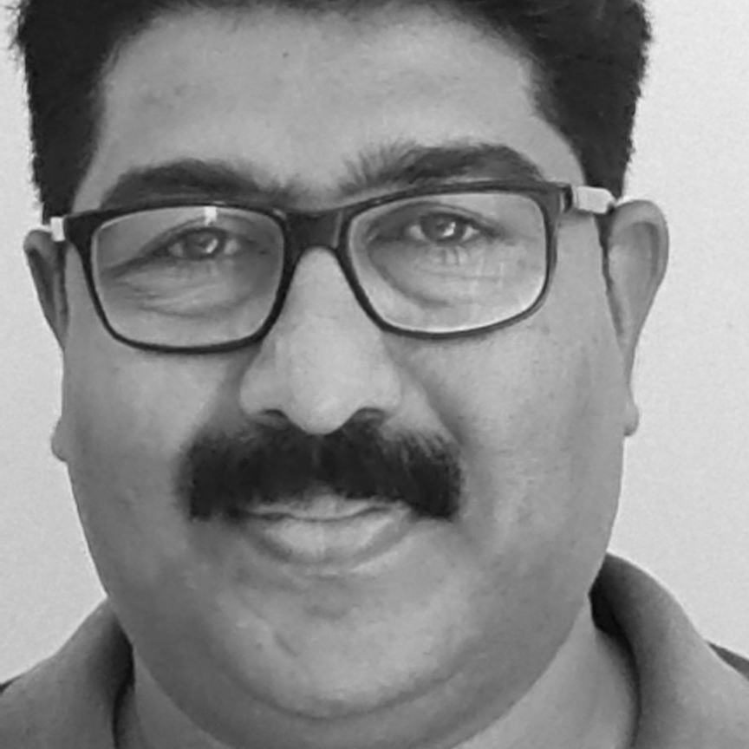
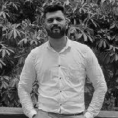
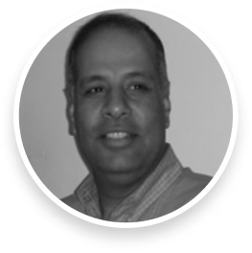
/ Team
Deep Technical Innovation
Dr. Suriyaprabha: Head of R&D
A Nanosciences PhD with extensive experience developing nanomaterials for wastewater treatment and environmental applications. With a strong publication record and hands-on research in sustainable water purification, she brings scientific rigor to real-world problem solving.
Dr. Alamelu K Ramasami: Energy Materials Specialist
Distinguished academician and researcher in energy materials and chemistry. Her research focuses on high-performance desiccant systems, electrolytic atmospheric separation technologies, hydrogen generation and storage, and advanced water treatment methodologies — directly powering Aeronero’s next-generation hybrid AWG R&D.
Dr. R. Velraj: Scientific Advisor
Academic leader with deep expertise in heat transfer, CFD, and energy storage. He has held senior roles at Anna University, including Director of the Institute for Energy Studies and Vice Chancellor from 2021 to 2024. Under his leadership, the university rose to a QS ranking of 383 and became the top state university in India per NIRF. He has published extensively, led major research projects, supervised 35 PhDs, and holds 9 patents. He is also recognized by Stanford University as a Top 2 percent scientist in Energy.
Dixon Joseph P.A: Head of Engineering/Innovation
HVAC and refrigeration expert with 30+ years of experience across India and the Middle East. Led plant operations and AWG system manufacturing, with deep technical expertise in cold storage systems, motor winding, and large-scale installation and maintenance. He holds a Diploma in Refrigeration.
Avinash Chougule: Sr. Product Designer
Engineering service provider specializing in product design, development, and precision engineering solutions with extensive experience in roles such as Assistant Lead Design and Design Engineer. He holds a B.E. in Mechanical Engineering from Rajendra Mane College of Engineering & Technology.
Solomon Saul: Technical Advisor
Visionary leader with 20+ years driving transformation in finance, strategy, and global P&L management. Currently CFO at MGA Entertainment, formerly CXO at Disney. Holds a degree from the Yale School of Management.

Slide 27

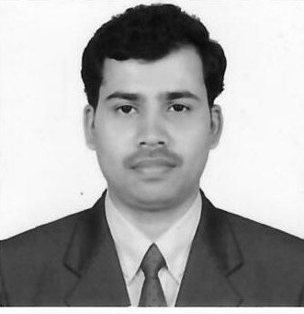
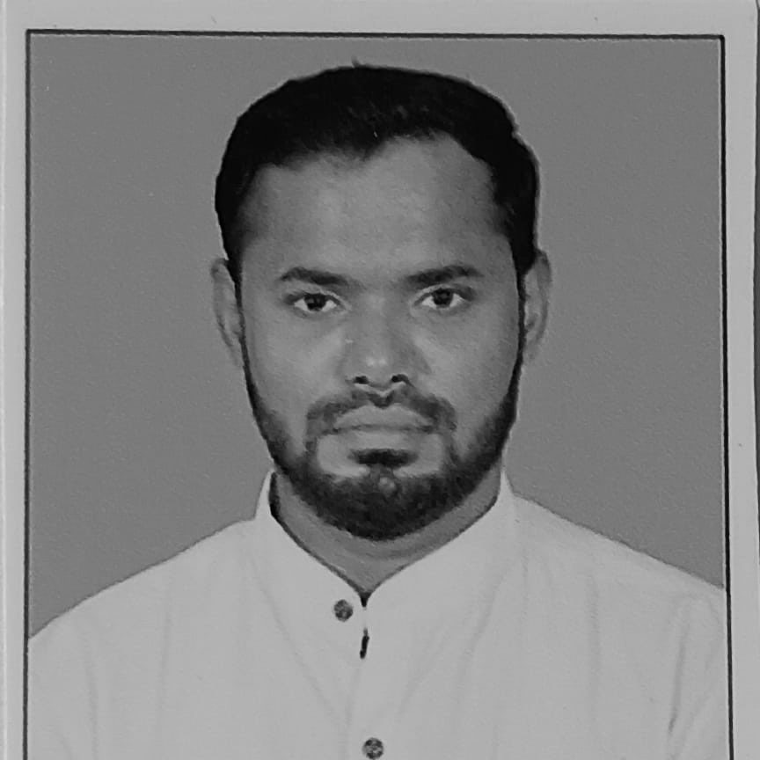
/ Team
Operations,
Production
Hilda Philip: Head of Operations
Business development and marketing leader with a strong track record in the maritime and technology sectors, known for driving revenue and strategic partnerships. She holds a BBA from Kalinga University and has completed professional certifications from Google, UC San Diego, HKUST, and the University of Pennsylvania.
Pratap N S: Quality Control
Operations leader with 25+ years of experience in manufacturing, production engineering, and design management. He has led cross-functional teams at Toyota Kirloskar, AUMA, and Satchitanand Precision Tooling, driving lean manufacturing, ISO compliance, and large-scale productivity gains across multiple plants. Pratap holds a Bachelor’s in Mechanical Engineering from Mahatma Gandhi Vidyapeeth Institute of Management & Technology, Delhi, and a Diploma in Mechanical Engineering from D.R.R. Government Polytechnic, Davanagere.
Zahir Hussain: Production Manager
Dedicated Production Manager with 12 years of experience in the refrigeration and electrical electronics industry, passionate about optimizing processes and fostering safe, productive environments for his team. He holds a diploma in Telecommunication Hardware and Software from the RDO Institute and certifications in Data Science and Machine Learning from Entri Elevate.

Slide 28

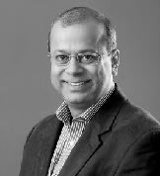
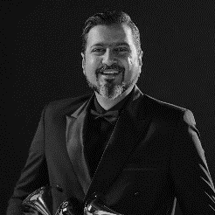
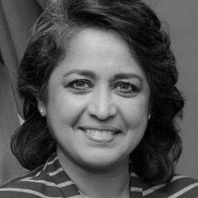
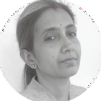
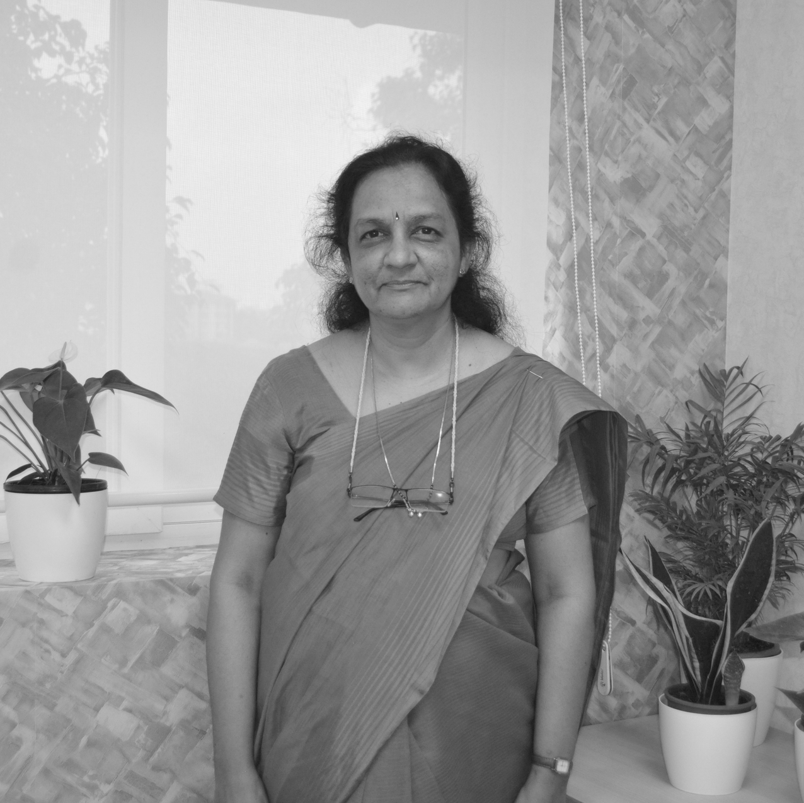
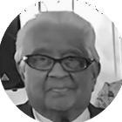
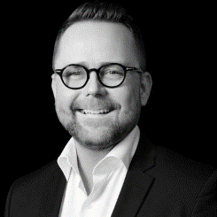
/ Team
Advisors
S. Ramadorai: Advisor
Renowned technocrat and former CEO of Tata Consultancy Services, where he scaled the company from $155 million to $6 billion. He has held key national leadership roles in skilling, governance, and public policy. He holds a B.Sc. in Physics from Delhi University, a B.E. in Electronics & Telecommunications from IISc Bengaluru, and an M.S. in Computer Science from UCLA, along with executive training from MIT Sloan.
Kiran Deshpande: Advisor
Veteran technology leader and entrepreneur with over four decades of experience, including a successful startup exit (Mojo Networks) and leadership roles at Tech Mahindra and TCS. He holds an M.Tech. in Electrical Engineering from IIT Bombay and a B.E. (Hons.) in Electronics from BITS Pilani.
Ricki Kej: Ambassador and Advisor
Three-time Grammy Award–winning composer, environmentalist, and UN Goodwill Ambassador whose work sits at the intersection of music, sustainability, and global impact; composed for 3,500+ projects, performed at the UN General Assembly, World Economic Forum, and across 30+ countries, and serves as Ambassador for UNHCR, UNESCO MGIEP, and Earth Day Network. His albums Winds of Samsara and Divine Tides (with Stewart Copeland) earned Grammy wins, and his work has received 100+ awards across four continents championing climate action.
Dr. Ameenah Gurib-Fakim: Advisor
Biodiversity scientist and former 6th President of the Republic of Mauritius (2015–2018), the country's first female head of state. A globally recognized leader in sustainability and African scientific development, she previously served as Managing Director of CIDP Research and Innovation and as Professor of Organic Chemistry at the University of Mauritius. She holds a B.Sc. in Chemistry from the University of Surrey and a Ph.D. from the University of Exeter, along with seven honorary doctorates and recipient of the L'Oréal-UNESCO Prize for Women in Science.
Meera Siva: Advisor
Experienced early-stage investor and finance professional, CFA charterholder, with 13 years in finance and 16 years in engineering; managed Shelter Venture Fund, advised startups, ran accelerators, authored finance articles, and holds multiple patents. She holds a Bachelor of Engineering in Electronics and Communication Engineering from the College of Engineering, Guindy.
Dr. Purnima Jalihal: Chief Scientist
Global expert in ocean energy and desalination with decades of leadership in advancing renewable water and energy solutions. Formerly Head of the Energy and Fresh Water group at India’s National Institute of Ocean Technology, she pioneered ocean thermal desalination (OTEC) and has advised governments, international agencies, and academic institutions worldwide. She holds a Ph.D. in Civil Engineering from Duke University, USA.
Bob Murari: Advisor
P. Murari, MA (Economics) from Madras University, served in the Indian Administrative Service (IAS) from 1957 to 1992, holding various esteemed positions including Secretary to the President of India. Currently, he advises the President of FICCI.
Jesper Munkholm: Advisor
Experienced innovation and water-tech leader with 15+ years across digital platforms, corporate innovation, and growth strategy; founder of an early smartphone-based QHSE SaaS platform (acquired), former Director at Grundfos Futurelab driving group-level water innovation, and co-founder of Water Impact Partners, a global growth partner for water technology companies and investors. Brings experience in M&A advisory and board leadership across SaaS, PaaS, and industrial sectors.

Slide 29






Building Water Independence for Humanity!
Access to safe drinking water is one of the defining challenges of our century. AeroNero believes the future of water must be decentralized, sustainable, and resilient. Through AWG systems, PAAS, WAAS, and AQUAIR, we enable communities, businesses, and institutions to produce clean water directly from air — reducing dependence on fragile supply chains and groundwater depletion. Our mission: To enable water independence for homes, cities, and communities across the world.
1-800-419-4190
hello@aeronero.com
/aeronero global
@aeroneroglobal
@aeronero.intl
@aeroneroglobal
www.aeronero.life
Aeronero Global

